Slide 1
EXPLORATORY DATA ANALYSIS
Intro to Machine Learning

Slide 2
WHAT IS EDA?
The analysis of datasets based on various numerical methods and graphical tools.
Exploring data for patterns, trends, underlying structure, deviations from the trend, anomalies and strange structures.
It facilitates discovering unexpected as well as conforming the expected.
Another definition: An approach/philosophy for data analysis that employs a variety of techniques (mostly graphical).

Slide 3
Objective of EDA
Maximize insight into a dataset
Uncover underlying structure
Extract important variables
Detect outliers and anomalies
Test underlying assumptions
Develop valid models
Determine optimal factor settings (Xs)

Slide 4
Objective of EDA
The goal of EDA is to open-mindedly explore data.
Tukey: EDA is detective work… Unless detective finds the clues, judge or jury has nothing to consider.

Slide 5
Steps of EDA
Generate good research questions
Data restructuring: You may need to make new variables from the existing ones.
  Instead of using two variables, obtaining rates or percentages of them
  Creating dummy variables for categorical variables
Based on the research questions, use appropriate graphical tools and obtain descriptive statistics. Try to understand the data structure, relationships, anomalies, unexpected behaviors.
Try to identify confounding variables, interaction relations and multicollinearity, if any.
Handle missing observations
Decide on the need of transformation (on response and/or explanatory variables).
Decide on the hypothesis based on your research questions

Slide 6
Classification of EDA
Exploratory data analysis is generally cross-classified in two ways. First, each method is either non-graphical or graphical. And second, each method is either univariate or multivariate (usually just bivariate).
Non-graphical methods generally involve calculation of summary statistics, while graphical methods obviously summarize the data in a diagrammatic or pictorial way.
Univariate methods look at one variable (data column) at a time, while multivariate methods look at two or more variables at a time to explore relationships. Usually our multivariate EDA will be bivariate (looking at exactly two variables), but occasionally it will involve three or more variables.
It is almost always a good idea to perform univariate EDA on each of the components of a multivariate EDA before performing the multivariate EDA.

Slide 7
Example
9 variables fro 329 metropolitan areas
Climate mildness
Housing cost
Health care and environment
Crime
Transportation supply
Educational opportunities and effort
Arts and culture facilities
Recreational opportunities
Personal economic outlook
+ latitude and longitude of each city
Questions:
How is climate related to location?
Are there clusters in the data (excluding location)?
Are nearby cities similar?
Any relation bw economic outlook and crime?
What else???

Slide 8
Data Types and Measurement Scales
Variables may be one of several types, and have a defined set of valid values.
Two main classes of variables are:
Continuous Variables: (Quantitative, numeric).
  Continuous data can be rounded or \binned to create categorical data.
Categorical Variables: (Discrete, qualitative).
  Some categorical variables (e.g. counts) are sometimes treated as continuous.

Slide 9
Categorical Data
Unordered categorical data (nominal)
  2 possible values (binary or dichotomous)
    Examples: male/female, alive/dead, yes/no.
  Greater than 2 possible values - No order to categories
    Examples: colors, religion, nationality.
Ordered categorical data (ordinal)
  Ratings or preferences
  Education level: high school < bachelor’s < master’s < PhD
  Customer satisfaction: very dissatisfied < dissatisfied < neutral < satisfied < very satisfied
  T-shirt sizes: small < medium < large < extra-large

Slide 10
Summarizing Data With Tables and Plots

Slide 11
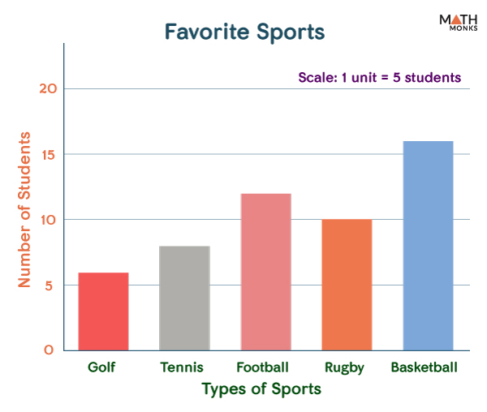
Bar Chart
• Data Type: Categorical
• Use: Displays counts or values across distinct categories.
➤ Easy way to compare category performance or frequency.

Slide 12
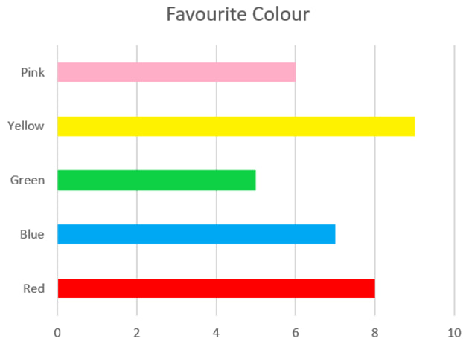
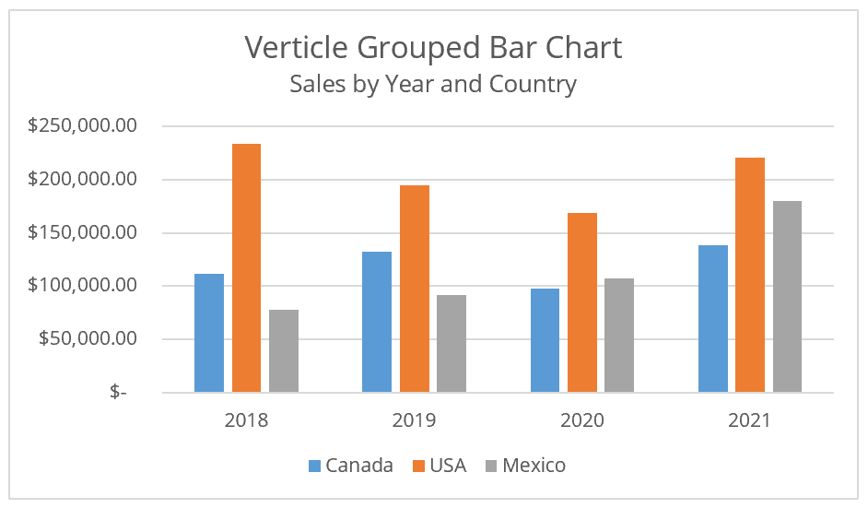
Bar Chart

Slide 13
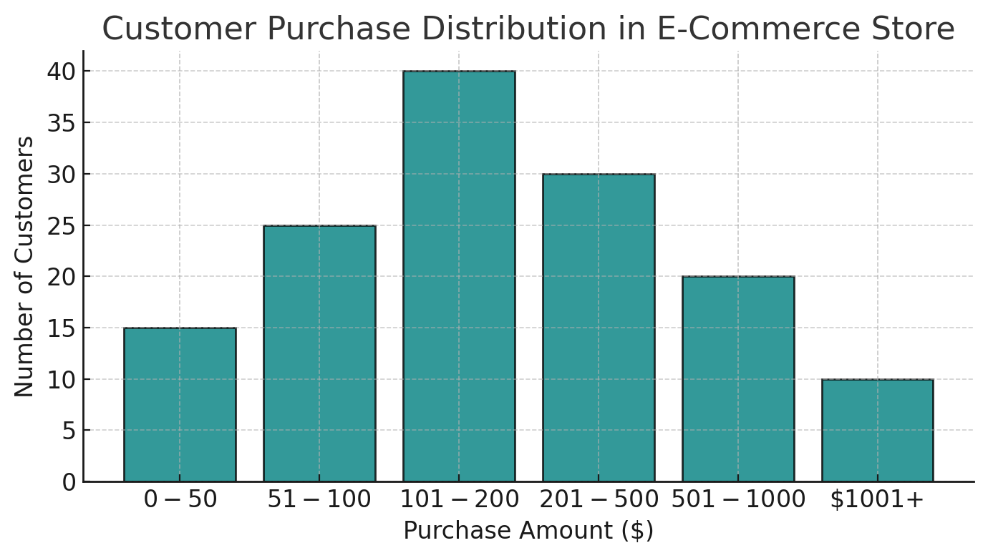
Histogram
• Data Type: Continuous
• Use: Visualizes the distribution of a numeric variable by grouping data into bins.
➤ Helps detect skewness, peaks, and spread.

Slide 14
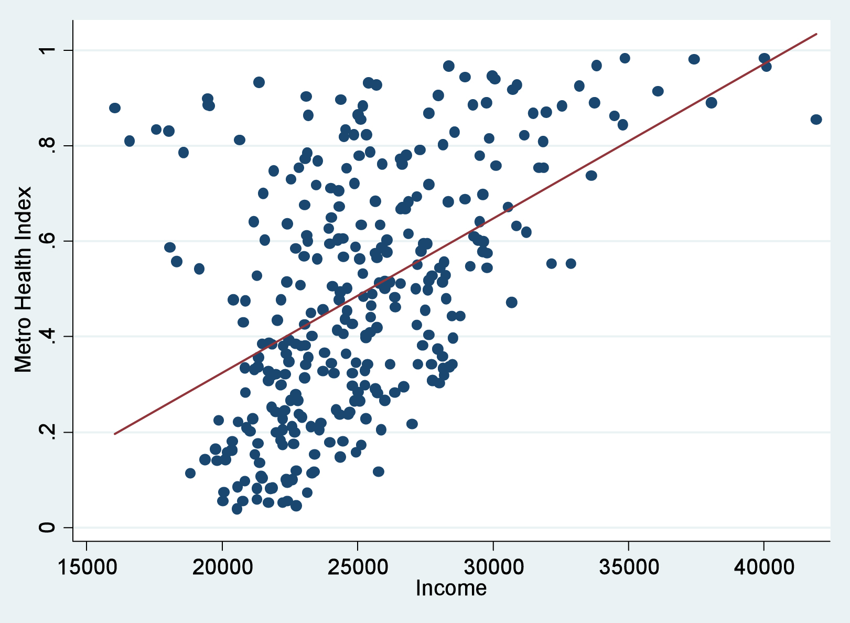
Scatter Plot
• Data Type: Continuous
• Use: Plots the relationship or correlation between two numeric variables.
➤ Reveals trends, clusters, or outliers.

Slide 15
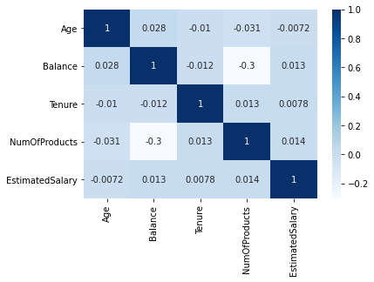
Correlation Heatmap
• Data Type: Continuous (matrix)
• Use: Color-coded matrix showing correlation coefficients between features.
➤ Helps detect multicollinearity or strong linear relationships.

Slide 16
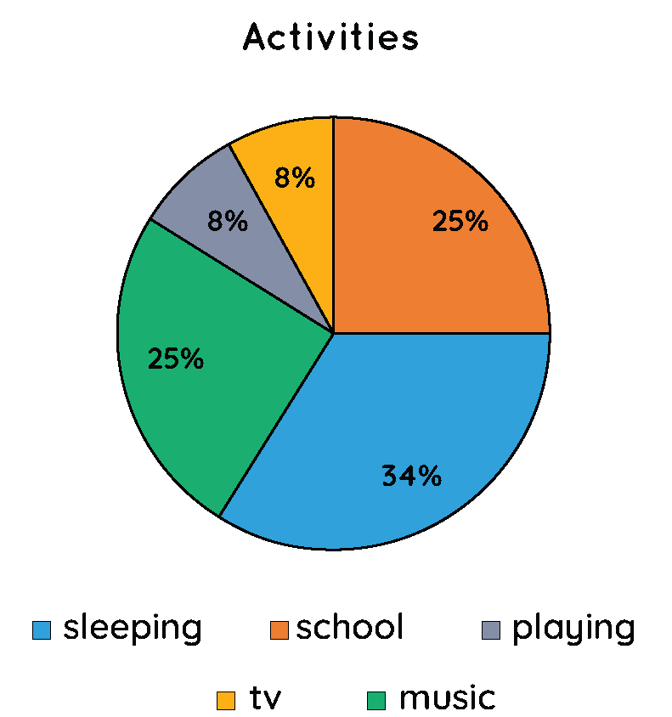
Pie Chart
Data Type: Categorical
Use: Circular chart divided into slices to illustrate numerical proportions of categories.
➤ Helps visualize the relative percentage or share of categories within a whole. Useful when comparing a small number of categories.

Slide 17
Thank You

